Slide 1
Journal club 7
Facilitator: pawin puapornpong

Slide 2
International Journal of Reproduction, Contraception, Obstetrics and Gynecology
Verma M et al. Int J Reprod Contracept Obstet Gynecol. 2016 Nov;5(11):3654-3658

Slide 3
INTRODUCTION
Around 56 million abortions occur each year in the world
Safe and effective treatment for incomplete abortion is an important way to reduce abortion related morbidity and mortality
Medical methods for treatment of incomplete abortion require few resources and can be administered by low and midlevel providers

Slide 4
INTRODUCTION
Surgical methods are highly effective for treatment of incomplete abortion.
However, these treatments require trained providers, special equipment, sterile conditions and often aneasthesia. All of which are limited in many settings.

Slide 5
INTRODUCTION
Aims and objectives of the study were
To study the role of Misoprostol in 1st trimester incomplete and missed abortions
To assess the effectiveness and acceptability of using vaginal Misoprostol for management of spontaneous incomplete and missed miscarriage
To compare the efficacy and patient satisfaction of the medical method with surgical method in treating patients with a miscarriage in a randomized setting
To study the incidence and risk factors of immediate complications of medical and surgical induced miscarriage

Slide 6
METHODS
Conducted in the Department of Obstetrics and Gynecology, M.G.M. Medical College and M.Y. Hospital, Indore (M.P.)
September 2014 to September 2015
Prospective comparative study

Slide 7
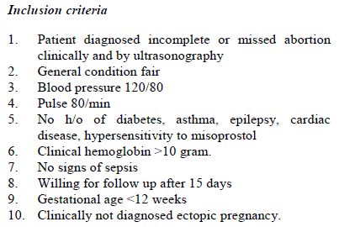
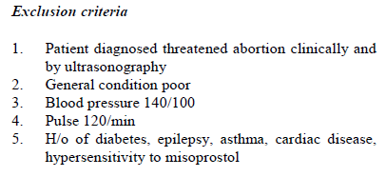
First trimester incomplete and missed miscarriage between 5 and 12 weeks
(200 patients)
Underwent surgical vaginal evacuation directly
under local anesthesia (para-cervical block).
Received Misoprostol tablet 600 mcg single dose

Slide 8
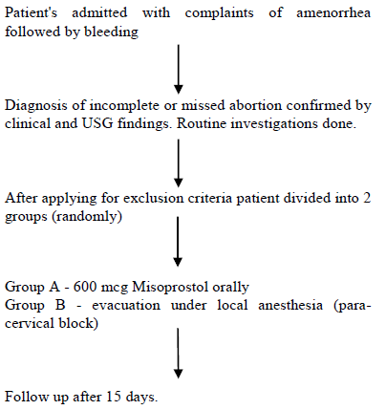
USG done to confirm complete evacuation of the retained products
amount of bleeding, sepsis, pain, requirement for re evacuation and patient satisfaction was assessed by a detailed history pro-forma

Slide 9
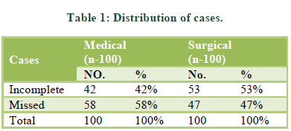
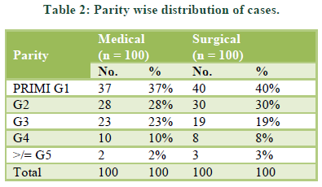
RESULTS

Slide 10
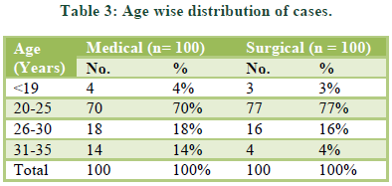
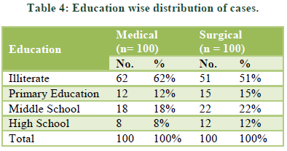
RESULTS

Slide 11
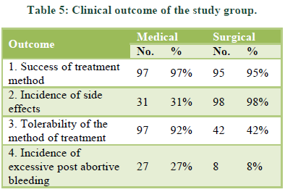
RESULTS

Slide 12
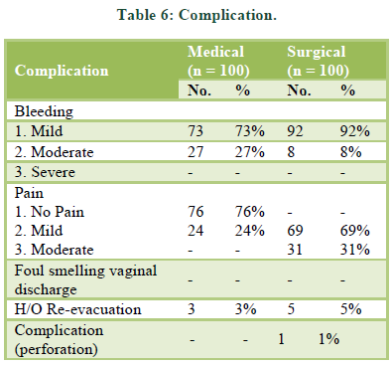
RESULTS

Slide 13
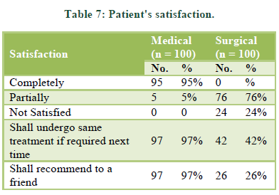
RESULTS

Slide 14
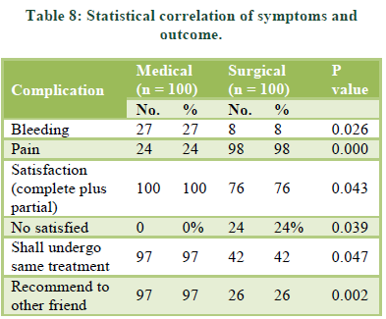
RESULTS

Slide 15
DISCUSSION
97% success rates were obtained in the medical group
Most study show high success rates have been found in many studies (79.6%-99%)
Some study, Chung et al did not find very good success rate(50%), but all sort of complications serious and mild were less in the medical group in their study

Slide 16
DISCUSSION
The numbers of patients with post abortal bleeding were more in the medical group significantly (p value =0.026)
Many studies conducted indicate similar results

Slide 17
DISCUSSION
All patients but 2 (grand multigravidas) complained of excruciating pain during and after the procedure
Only 24 patients in the medical group complained of having moderate amount of lower abdominal cramping pain.

Slide 18
DISCUSSION
100% patients were satisfied with the medical management, while only 76% patients were satisfied with the surgical evacuation
These results showed significant statistical correlation (p value =0.043)
Similar results were found in other studies whilst Madagascar 7 maldova(97%) conclude that the best features of medical treatment were it being quick, easy convenient, and also avoided surgical intervention and the related complications

Slide 19
DISCUSSION
97 % patients in the medical group said that they were willing to undergo same treatment in the next time
Only 42% women said they would undergo same surgical evacuation
The statistics in this respect also showed correlation (p value =0.047)

Slide 20
CONCLUSION
The estimated abortion percentage of known pregnancies was at 21% worldwide
Given its safety, efficacy, and ease of use, misoprostol is an important option for the treatment of women with incomplete abortion
This research study done by us shows how misoprostol can be provided in low-resource settings

Slide 21
CONCLUSION
American College of Obstetricians and Gynecologists recommend misoprostol for postabortion care and the World Health Organization has added misoprostol for the management of incomplete abortion and miscarriage to its Model List of Essential Medicines
The available Cochrane systematic review evidence suggest that expectant care as well as medical treatment with misoprostol are acceptable alternatives to routine vaginal surgical evacuation
Funding: No funding sources
Ethical approval: The study was approved by the Institutional Ethics Committee

