Slide 1
Perimenopause & Postmenopause Women
Facilitator: Pawin Puapornpong

Slide 2
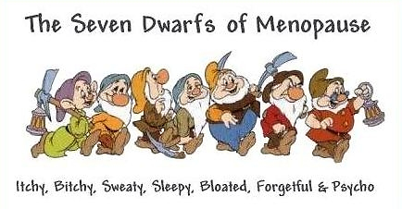
Perimenopause
Menopausal transition - วัยก่อนหมดระดู
Average 2-8 yrs – ends with last period
Transition towards permanent infertility

Slide 3
Perimenopause - Physiology
↓Follicle remains due to sharp decline = hypothalamus still intact & over work (↑FSH) = recruit more follicles = ↑Estrogen
Imbalance fluctuations
Follicles may still be able to grow and ovulate but less = don’t ovulate every cycle → perimenopausal symptoms
As you get near menopause: ↑FSH but ↓Follicle = ↓Estrogen

Slide 4
Perimenopause - Physiology

Slide 5
Perimenopause Symptoms (45-54 years old)

Slide 6
Vasomotor Symptoms
(Hot flashes)
~75% of perimenopause women
Last for 1-2 years after menopause but can be up to 10 years or longer in others
Character: usually starts at face/neck/head/chest/earlobe/forehead, spreading to any directions
Duration: sec-hrs
+/- Asss symptoms: เหงื่อออก/ ผิวหนังร้อน/ หงุดหงิด/อ่อนเพลีย/นอนไม่หลับ/ ปวดหัว/ใจสั่น
Affects: daily activities & sleep & psychological
Severity: increases in over-weight & smokers
MOA: incompletely understood
Possibly Estrogen withdrawal
Possibly Peripheral vasomoter instability in women with low estrogen levels

Slide 7
Psychological Symptoms
Common during perimenopause- worsen 2-3 years prior menopause
Symptoms: frequent...
mood changes eg depression, anxiety, tiredness
Decrease concentration at work
Forgetful & irritation
MOA:
Hormonal change ( decrease estrogen)
May decrease responsiveness of Dopamine receptor
OR: decreases Tryptophan (precursor of serotonin neurotransmitter in CNS)
Severity: environmental factors eg family & social supports
May worsen by Premenstrual Syndromes

Slide 8
Cognition and Alzheimer’s disease
Degeneration of neurotransmitters and neurons
Not related to the lack of estrogen but rather hot flashes
M/C: verbal memory deficit
Estrogen supplement only help if given as 1º prevention (before onset of symptoms)

Slide 9
Skin changes
Skin turgor ⬇
Dry and thin
Fragile nails
Alopecia
Due to loss of tissue collagen
(~30% w/i 1st year)

Slide 10
Long term impacts
Cardiovascular diseases & MI
Estrogen fn to ⬇LDL ⬆ HDL
Thus,⬇ estrogen = increasing the risk of atherosclerosis
Osteoporosis
Due to ⬆ osteoclast activity & ⬆ bone resorption
Dx: Bone Mass Density (BMD)

Slide 11
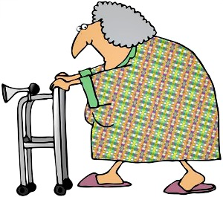
Postmenopause
Meaning : วัยหลังหมดระดู โดยนับหลังจากมีประจำเดือนครั้งสุดท้าย 1 ปี

Slide 12
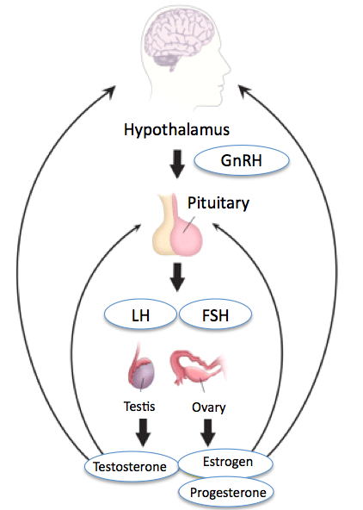
Physiological change
Increased in FSH & LH levels
Gonadotropin increase to maximum level within 2-3 years after menopause, then gradually decrease
FSH:LH > 1
cyclic or rhythmic release
Decreased in Estrogen level
Androstenedione and testosterone can still be produced by the ovary
Estrogen are in the form of estrone (from aromatization of androstenedione in fat tissue)
Increased in LDL levels
Increased in Testosterone : Estrogen ratio
Mild hirsutism

Slide 13
Postmenopause: Pathology
Related primarily to estrogen deficiency
Principal health concerns in postmenopausal women: vasomotor symptoms, urogenital atrophy, osteoporosis, cardiovascular disease, cancer, cognitive decline, sexual problems

Slide 14
Vasomotor Symptoms
Hot flashes
Driven by hypothalamus or noradrenergic, serotoninergic, dopaminergic activation
⬆ core body temp. , metabolic rate, and skin temp
→peripheral vasodilation & sweating
Due to estrogen withdrawal
Last for 1-2 years after menopause (~10 yrs)
Face, neck, head, chest → spread
Associated with sweating, fatigue, irritation, insomnia, headache, palpitation : peripheral vasomotor instability

Slide 15
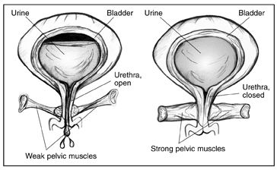
Urogenital atrophy
Estrogen deficiency → ⬇blood flow to urogenital organs
ผิวหนังบางลง, ขนน้อยลง, ปากช่องคลอดแคบ, Vaginal dryness
→ atrophic vaginitis, dyspareunia
กล้ามเนื้อหูรูดท่อปัสสาวะ
อ่อนแอ
→ อักเสบง่าย,
dysuria, urinary urgency
+ ⬆ frequency

Slide 16
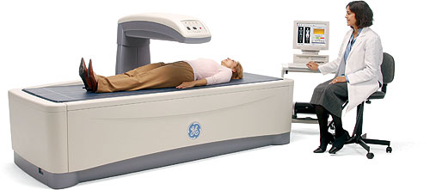
Osteoporosis
มวลกระดูกลดลง → ⬆ risk of fracture
⬆osteoclastic activity → ⬆bone resorption
M/C cause in females: Estrogen deficiency
Risk factors
Non-modifiable: age, family history, race, prior fracture, small body frame, early menopause
Modifiable: smoking, ⬇ intake of calcium & vit D
Screening
Bone mineral density of hip
and spine
Dual x-ray absorptiometry of
hip and spine
Lean body mass & fat mass

Slide 17
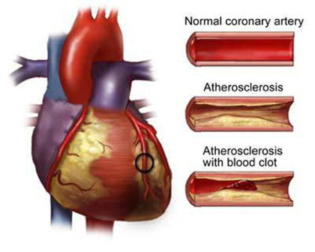
Cardiovascular Disease
WHI RCT: combination hormone therapy vs placebo
No evidence for hormone therapy as heart disease prevention
Reassurance that hormone therapy doesn’t increase risk of CVD

Slide 18
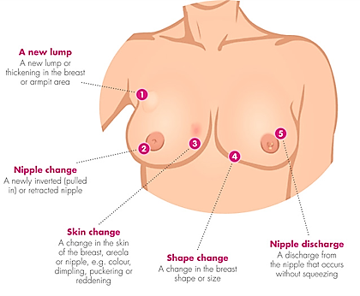
Breast Cancer
WHI RCT: significant increase in risk of invasive breast cancer after ~5 years of hormone therapy
Hormone therapy contraindications
Previous history of breast cancer
High risk for breast cancer — use with carefull assessment

Slide 19
Alzheimer’s disease
Greater risk in F than M
RCT: hormone therapy neither slow disease progression nor improve cognition
WHIMS RCT: hormone therapy —> 2x increased risk of dementia (Alzheimer’s)
Lower modified MMSE when on hormone therapy
Hypothesis: small, undetected cardiovascular events

Slide 20
Sexual dysfunction
Increased pain during SI
Decreased sexual desire
Other factors: age, social, health factors, psychological factors

Slide 21
Hormone therapy
given 5-10 years for symptom control
at least 10-20 years for osteoporosis & CVD prevention

Slide 22
Indications for Hormone therapy
Alleviation of menopausal symptoms
Vasomotor symptoms
Hot flushes
Sweating
palpitations
Urogenital symptoms
Vaginal dryness
Dyspareunia
Urinary frequency
Osteoporosis: ↓hip&vertebral fractures
Notes:
MHT is also effective and appropriate for the prevention of osteoporosis related fracture in at risk women within 10 years of the menopause
The risk of VTE and stroke increases with oral MHT but the absolute risk is rare before age 60.
In women within 10 years of the menopause MHT does not increase the risk of coronary heart disease.
Combined MHT use for more than 5 years may be associated with an increased risk of breast cancer. This risk appears to be related to the use of a Progestogen and duration of therapy.
Oestrogen only MHT does not increase risk of breast cancer
Oestrogen only therapy is appropriate for women who have undergone. Hysterectomy. Oestrogen plus Progestogen should be used in women with an intact uterus.
https://www.google.co.th/url?sa=t&rct=j&q=&esrc=s&source=web&cd=6&cad=rja&uact=8&ved=0CEsQFjAFahUKEwi0iO_1xrDHAhUDG44KHZw7Cb8&url=https%3A%2F%2Fwww.ranzcog.edu.au%2Fdoc%2Fhormone-replacement-therapy-advice.html&ei=Cg7SVbTbDoO2uASc96T4Cw&usg=AFQjCNGbVGffNs5u7oGQl0Ns3pD4Qro3Hw&bvm=bv.99804247,d.c2E
http://emedicine.medscape.com/article/276104-overview#a6

Slide 23
Contraindications
A history of breast cancer
A history of endometrial cancer
Porphyria
Severe active liver disease
Hypertriglyceridemia
Thromboembolic disorders
Undiagnosed vaginal bleeding
Endometriosis
Fibroids

Slide 24
 | Estradiol | Bazedoxifene(conjugated estrogen) | Premarin (conjugated estrogen) | Menest (esterified estrogen) | Premarin vaginal cream
Indications | Vulvar and vaginal atrophy |  |  | Pallitive for CA breast | Dyspareunia
 |  | Osteoporosis
 |  |  | Atrophic vaginitis
 |  |  |  | Kraurosis vulvae
 | Vasomotor symptoms
Warnings | ↑CA endometrial ↑Endometrial hyperplasia ↑stroke&DVT ↑dementia ↑CA breast
Contraindications | Hypersensitivity, Known anaphylactic reaction, Thrombophilic disorder, CA breast, Arterial thromboembolic disease, Estrogen-dependent neoplasia, HT, DM with vascular involvement, jaundice c previous OC use, Undiagnosed abnormal vaginal bleeding, Liver disease, Porphyria
Notes:
http://reference.medscape.com/drug/estrace-vivelle-dot-estradiol-342766#4
http://reference.medscape.com/drug/estrogens-esterified-menest-342778
http://reference.medscape.com/drug/duavee-bazedoxifene-conjugated-estrogens-999876
http://reference.medscape.com/drug/premarin-estrogens-conjugated-342771
http://reference.medscape.com/drug/premarin-vaginal-cream-conjugated-estrogens-vaginal-999949

Slide 25
Conjugated Estrogens
CONJUGATED EQUINE ESTROGENS (systemic)
Indications:Treatment
vasomotor symptoms with menopause
vulvar and vaginal atrophy due to menopause
hypoestrogenism (due to hypogonadism, castration, or primary ovarian failure)
postmenopausal osteoporosis (prophylaxis)
abnormal uterine bleeding
prostatic cancer (palliation) breast cancer (palliation)
F.D.A 2015 online http://www.accessdata.fda.gov/drugsatfda_docs/label/2006/004782s147lbl.pdf

Slide 26
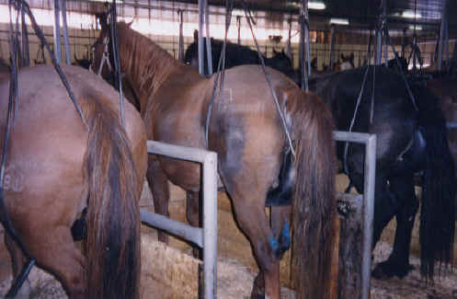
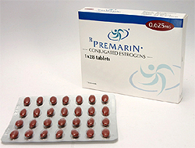
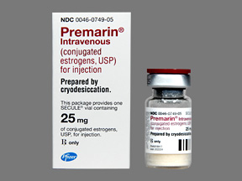
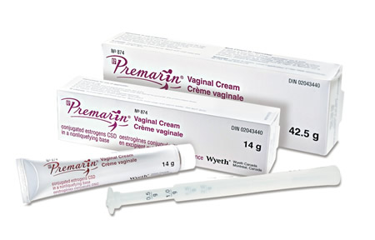
Conjugated Estrogens
Available dosage form in the hospital:
Conjugated estrogens 0.625MG CREAM
Conjugated estrogens 0.625MG TAB
Conjugated estrogens 1.25MG TAB
Thai National list of Medicine 2013
Conjugated estrogens tab บัญชียา ข
Conjugated estrogens vaginal cream บัญชียา ข
Conjugated estrogens sterile pwdr บัญชียา ค

Slide 27
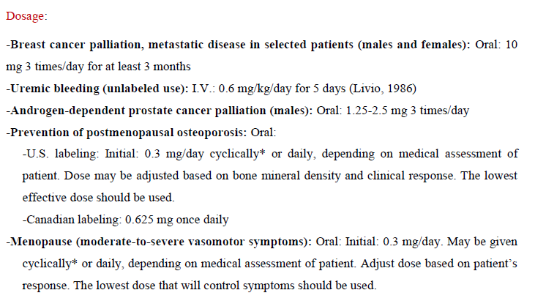
F.D.A 2015 online http://www.accessdata.fda.gov/drugsatfda_docs/label/2006/004782s147lbl.pdf

Slide 28
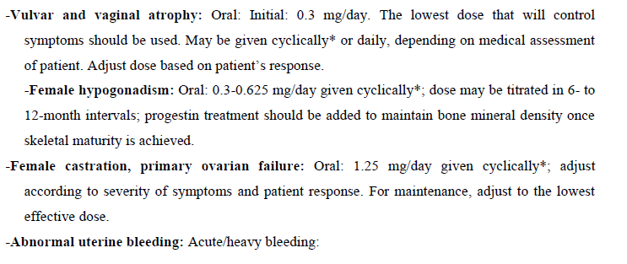
F.D.A 2015 online http://www.accessdata.fda.gov/drugsatfda_docs/label/2006/004782s147lbl.pdf

Slide 29
F.D.A 2015 online http://www.accessdata.fda.gov/drugsatfda_docs/label/2006/004782s147lbl.pdf

Slide 30
Conjugated Estrogens
Adverse Effects >10% ^{[1]}
Abdominal pain (15-17%) Back pain (13-14%) Breast enlargement Breast tenderness (7-12%) Headache (26-32%) Arthralgia (7-14%)
Pharyngitis (10-12%) Sinusitis (6-11%) Diarrhea (6-7%)
Black Box Warnings
Estrogens alone increase risk of endometrial cancer ; OR 1.6 (95% CI = 1.1–2.4) after 5 or more years ^{[2]}
Estrogens alone increased risk of breast cancer : RR 1.38( 95% CI 1.27-1.49) ^{[3]}
Estrogens alone increase Cardiovascular risks less than 34 years (odds ratio [OR], 1.51; 95% CI, 1.13–2.03) ^{[4]}
Estrogens alone increase Dementia risks ^{[1]}
1 Medscape 2015 ; online reference.medscape.com/drug/premarin-estrogens-conjugated-342771#5
2 Elisabete Weiderpass, et al Risk of Endometrial Cancer Following Estrogen Replacement With and Without Progestins jn ci.oxfordjournals.org/content/91/13/1131
Opatrny L¹, Dell'Aniello S, Assouline S, Suissa S. Hormone replacement therapy use and variations in the risk of breast cancer. BJOG. 2008 Jan;115(2):169-75; discussion 175.
Cheryl Bushnell, MD, MHS Hormone Therapy and Stroke: Is It All About Timing? http://www.ncbi.nlm.nih.gov/pmc/articles/PMC3074540/

Slide 31
Conjugated Estrogens
Contraindications
Known anaphylactic reaction or angioedema
Known protein C, protein S, or antithrombin deficiency; other known thrombophilic disorders
Active or history of breast cancer
Arterial thromboembolic disease (stroke, MI), thrombophlebitis, DVT/PE, thrombogenic valvular disease
Liver disease, liver tumors
Uncontrolled hypertension, diabetes mellitus with vascular involvement, jaundice with previous oral contraceptive use
Estrogen-dependent neoplasia
Undiagnosed abnormal vaginal bleeding
1 Medscape 2015 online : reference.medscape.com/drug/premarin-estrogens-conjugated-342771#5

Slide 32
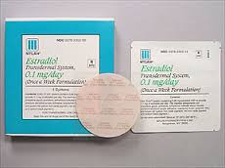
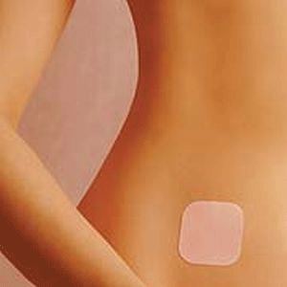
Transdermal Estrogen
vasomotor symptoms menopause .

Slide 33
Transdermal Estrogen
Estrogen and Thromboembolism Risk (ESTHER) study¹
Case-control study (271 cases, 610 controls)
Lower risk of VTE compared with oral E2 (OR 4.2)
Markers of inflammation unaffected²; triglycerides decreased³; less effect on SHBG and TBG²
Less favorable for HDL and LDL changes⁴
Patient preference important (transdermal vs oral)
Wide range of dosing options (mg/d): 0.014, 0.025, 0.0375, 0.05, 0.075, 0.1
SHBG = sex hormone-binding globulin; TBG = thyroxine-binding globulin.
1. Canonico M, et al. Circulation. 2007;115:840. 2. Shifren JL, et al. Endocrinol Metab. 2008;93:1702. 3. Sanada M, et al. Menopause. 2004;11:331. 4. Walsh BW, et al. N Engl J Med. 1991;325:1196.
Notes:
35

Slide 34
Progestin
 | Depo Provera (Medroxyprogesterone) | Aygestin, Norlutate (norethindrone acetate)
Indications | Alleviation of menopausal symptoms
Warnings | ↓bone mineral density ↑MI, stroke, invasive CA breast, PE, DVT ↑dementia
Contraindications | Thromboembolic disorders, cerebral vascular disease, malignancy of breast or genital organs, Undiagnosed vaginal bleeding, estrogen-or progesterone-dependent neoplasia, Known anaphylactic reaction or angioedema, Known liver impairment or disease, Documented hypersensitivity
 |  | DM with vascular involvement Jaundice with prior oral contraceptive use
http://emedicine.medscape.com/article/276104-overview
http://reference.medscape.com/drug/aygestin-norethindrone-acetate-342789#5
http://reference.medscape.com/drug/depo-provera-depo-subq-provera-104-medroxyprogesterone-342782#5
Notes:
http://emedicine.medscape.com/article/276104-overview
http://reference.medscape.com/drug/aygestin-norethindrone-acetate-342789#5
http://reference.medscape.com/drug/depo-provera-depo-subq-provera-104-medroxyprogesterone-342782#5

Slide 35
Adding Progestin
Cyclical vs Continuous
General S/E: breast tenderness, change in libido, abdominal pain, depression, nausea, weight gain, edema
Breakthrough bleeding
Endometrial hyperplasia / cancer
Ovarian cancer (rare: after 5-10 years of use)
Breast cancer – after 5 yrs of use
Notes:
add progestin to prevent endometrial hyperplasia & carcinoma. – lower rate of this + ovarian CA
if pt has underdone hysterectomy then there’s no need.
Cyclical for perimenopause with irregular menstrual cycle + want normal cycle
Continuous for 1 yr post menopause + don’t want mens

Slide 36
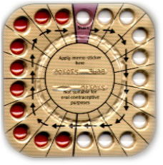
Cyclic regimens
Cyclic Estrogen + Cyclic Progestin – natural cycle
Climen: Estradiol valerate 2 mg (21 d) + Cyproterone 1 mg (10 d)
1 tab oral OD hs เว้นระหว่างแผง 7 วัน
Cycloprogynova: Estradiol valerate 2 mg (21 d) + Levonorgestrel 250 mg (10 d)
1 tab oral OD hs เว้นระหว่างแผง 7 วัน
Continuous Estrogen + Cyclic Progestin
Premarin (0.625) 1 tab OD (everyday) + Provera 2 tab OD (14 d)
http://www.cbh.moph.go.th/app/intranet/files/km/1385341275_Menopause.pdf
Notes:
http://www.cbh.moph.go.th/app/intranet/files/km/1385341275_Menopause.pdf

Slide 37
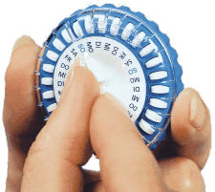
Continuous combined regimens
ให้ทุกวัน ไม่มีวันหยุด → endometrial atrophy
Activella
Estradiol 17β 1 mg + Norethisterone acitate (NETA) 0.5 mg
Angeliq
Estradiol 1,2 mg + Drosperienone 0.05 mg
Femoston-conti
Estradiol 2 mg + Dydrogesterone 10 mg
http://www.med.cmu.ac.th/dept/obgyn/2011/index.php?option=com_content&view=article&id=1009:benefit-and-risk-of-postmenopausal-hormone-therapy&catid=45&Itemid=561
Notes:
for: หมดปจด.มา 1 ปี + ไม่ต้องการมีอีก
** อาจมี breakthrough bleeding
http://www.med.cmu.ac.th/dept/obgyn/2011/index.php?option=com_content&view=article&id=1009:benefit-and-risk-of-postmenopausal-hormone-therapy&catid=45&Itemid=561

Slide 38
Non-conventional hormone therapy
Selective Estrogen Receptor Modulators ( SERM )
Raloxifen
Tamoxifen
Specific tissue estrogenic activity regulator (STEAR)
Tibolone
Phytoestrogen
Isoflavones : soybeans,lentils
Ligans : flaxseed, cereal
Coumestans : sprouts, sunflower seed

Slide 39
Phytoestrogens
What is it?
Nonsteroidal, naturally occuring polyphenols that is structurally similar to estradiol but their potencies are ~1000x weaker than 17alpha estradiol
Indications
menopausal vasomotor symptoms, osteoporosis, decrease risk of breast cancer and cardiovascular diseases

Slide 40
SERMs
Tamoxifen
Indications
Breast cancer
Ductal carcinoma in situ *
Breast cancer prevention *
Ovulation induction
Mastalgia
Contraindications
Hypersensitivity
Undiagnosed vaginal bleeding
History of thromboembolism *
Courmarin anticoagulation *
http://reference.medscape.com/drug/nolvadex-soltamox-tamoxifen-342183
Notes:
http://reference.medscape.com/drug/nolvadex-soltamox-tamoxifen-342183
Breast cancer
-Treatment of metastatic breast cancer (estrogen receptor positive tumors = more benefit)
-Adjuvant treatment of node-positive and axillary node-negative breast cancer in postmenopausal women following mastectomy, axillary dissection and breast irradiation
-Adjuvant treatment to reduces occurrence of contralateral breast cancer
Ductal carcinoma in situ
-ductal carcinoma in situ following breast surgery and radiation to reduce risk of invasive breast cancer
Breast cancer prevention
-reduce incidence of breast cancer in women at high risk (age ≥35 years with a 5-year predicted risk of breast cancer ≥1.67%

Slide 41
SERMs
Raloxifen
Indications
Osteoporosis in post-menopausal women
Prevention of invasive breast cancer in high risk postmenopausal women
Contraindications
Venous thromboembolism
Notes:
High risk of breast cancer is defined as at least 1 breast biopsy showing lobular carcinoma in situ (LCIS) or atypical hyperplasia, 1 or more first-degree relatives with breast cancer, or a 5-year predicted risk of breast cancer >1.66% (based on the modified Gail model)

Slide 42
STEAR - Tibolone
Indications
Postmenopausal osteoporosis
Contraindications
Breast cancer
Undiagnosed vaginal bleeding
Severe liver disease
High cardiovascular risk
Hypersensitivity

Slide 43
Non-Hormonal therapy

Slide 44
CONTROLLING HOT FLASHES (1)
Paroxetine 12.5-25 mg orally daily
Gabapentin 900 mg daily in divided doses
Herbal treatments-Black cohosh, 40 mg orally daily
Phytoestrogens- soybeans, chickpeas, lentils, flaxseed, lentils, grains, fruits, vegetables, and red clover

Slide 45
CONTROLLING HOT FLASHES (2)
Antidepressants
Fluoxetine, 20 mg orally
Paroxetine, 12.5-25 mg orally daily
Venlafaxine, 75 mg orally daily

Slide 46
CONTROLLING HOT FLASHES (3)
Progesterone
Megestrol, 20 mg orally twice a day
Medroxyprogesterone acetate, 20 mg orally daily
Medroxyprogesterone acetate, 100 mg orally twice a day
medroxyprogesterone, 500 mg intramuscularly every 2 weeks
Transdermal progesterone, 20 mg daily
Transdermal progesterone, 32 mg daily

Slide 47
Osteoporosis
Life style modification
Exercise
Food
Safety environment
finally… Drug

Slide 48
Life style modification
Exercise
Diet modification
Maintain cool environment

Slide 49
Thank you

