Slide 1
Journal club 4
Facilitator: Pawin Puapornpong

Slide 2
Influenza Vaccination of Pregnant Women and Protection of Their Infants
N Engl J Med 2014;371:918-31.
Shabir A. Madhi, M.D. and team

Slide 3
Introduction
Pregnant women are heightened susceptibility to severe influenza
The efficacy of inactivated influenza vaccine (IIV) in pregnant women may differ from nonpregnant women
This difference is increase in pregnant women infected with the human immunodeficiency virus (HIV)

Slide 4
In the recent, no published randomized, controlled trial has assessed the efficacy of IIV
The infants 6 months of age or younger
High risk for influenza-associated hospitalization
Immune responses to IIV vaccination are poor

Slide 5
Methods
Two studies
Pregnant women without HIV infection
IIV
Placebo
Pregnant women with HIV infection
IIV
Placebo
Evaluation
Immunogenicity
Vaccine efficacy
Safety

Slide 6
Cohort study
Randomized (computer-generated assignments)
Double-blind placebo-controlled trials
Conducted in Soweto, South Africa

Slide 7
The enrollment
Pregnant women without HIV infection
2011 and 2012 influenza season
Pregnant women with HIV infection
2011 influenza season

Slide 8
Inclusion criteria
Age of 18 to 38 years
Estimated gestation of 20 to 36 weeks
Ability to understand and comply with planned study procedures

Slide 9
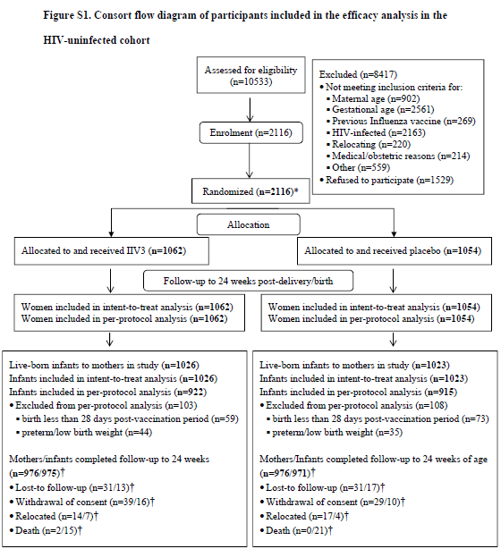

Slide 10
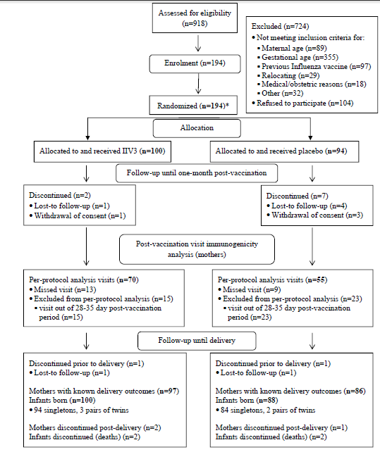

Slide 11
Primary objectives
Pregnant women without HIV infection
Vaccine efficacy to protecting their infants against confirmed influenza through 24 weeks of age
Compare maternal immunogenicity
Pregnant women with HIV infection
Compare maternal immunogenicity

Slide 12
Secondary objectives
Pregnant women without HIV infection
Vaccine efficacy to pregnant
Pregnant women with HIV infection
Vaccine efficacy to pregnant and their infants through 24 weeks of age

Slide 13
The studies were approved by the Human Research Ethics Committee of the University of the Witwatersrand

Slide 14
Influenza vaccine (Vaxigrip)
A/California/7/2009(A/[H1N1]pdm09)
A/Victoria/210/2009 (A/H3N2)
B/Brisbane/60/2008–like virus (B/Victoria)
Recommended by WHO for the Southern Hemisphere in 2011 and 2012

Slide 15
Immunogenicity
Antibody testing : Hemagglutination Inhibition [HAI]
Vaccine Efficacy
Test for influenza virus : RT-PCR assay

Slide 16
Sample size
Pregnant women without HIV infection
Base on the primary outcome(vaccine efficacy in the infants)
At least 27 cases of confirmed illness caused by influenza virus in infants up to 24 weeks of age
Pregnant women with HIV infection
180 participants

Slide 17
The intention-to-treat analyses
Maternal outcomes
Receipt of vaccine or placebo to 175 days after birth
Infant outcomes
Birth to 175 days of age

Slide 18
The per-protocol analyses for vaccine efficacy
Maternal outcomes
14 or more days after receipt of vaccine or placebo
Infant outcomes
Born at least 28 days after their mother’s vaccination
Gestational age at birth was at least 37 weeks
Birth weight of at least 2500 g

Slide 19
The per-protocol analyses for immunogenicity
Mother
Blood sample was obtained 28 to 35 days after vaccination
Infant
Blood sample was obtained within 7 days after birth
Gestational age of at least 37 weeks
Birth weight of at least 2500 g.

Slide 20
Study data were collected and managed with the use of Research Electronic Data Capture (REDCap), version 5.9.13
All statistical analyses were conducted with the use of Stata software, version 12.1

Slide 21
Result

Slide 22
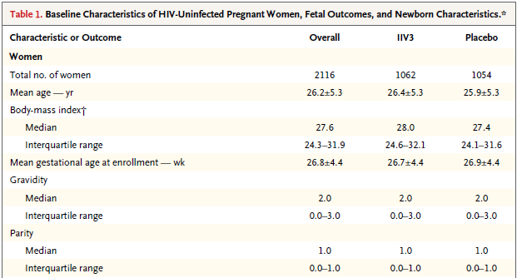

Slide 23
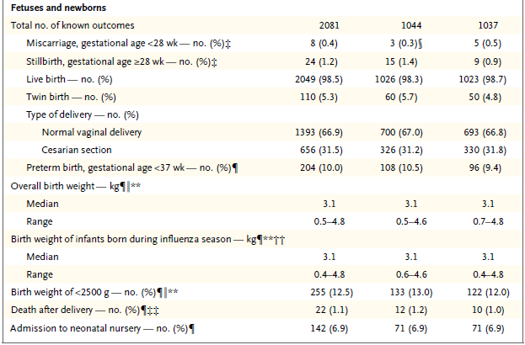

Slide 24
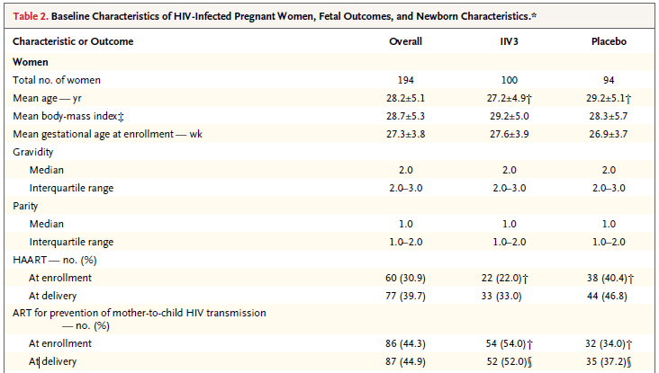

Slide 25
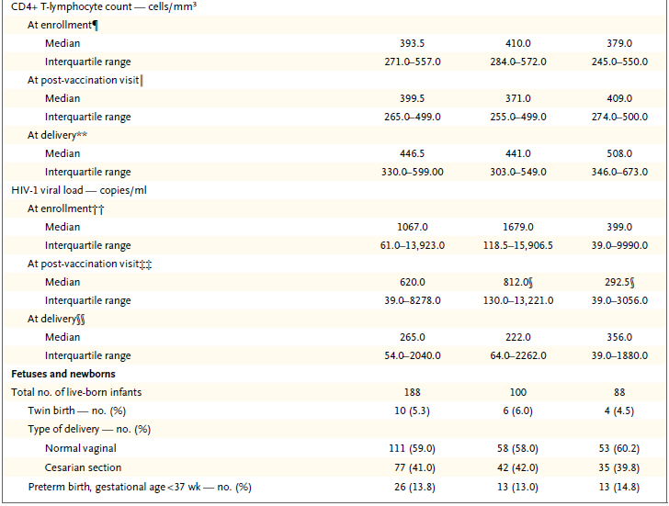

Slide 26
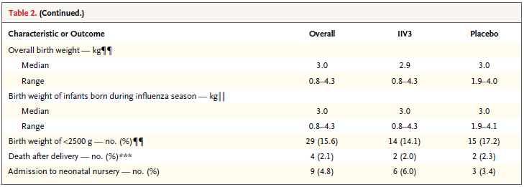

Slide 27
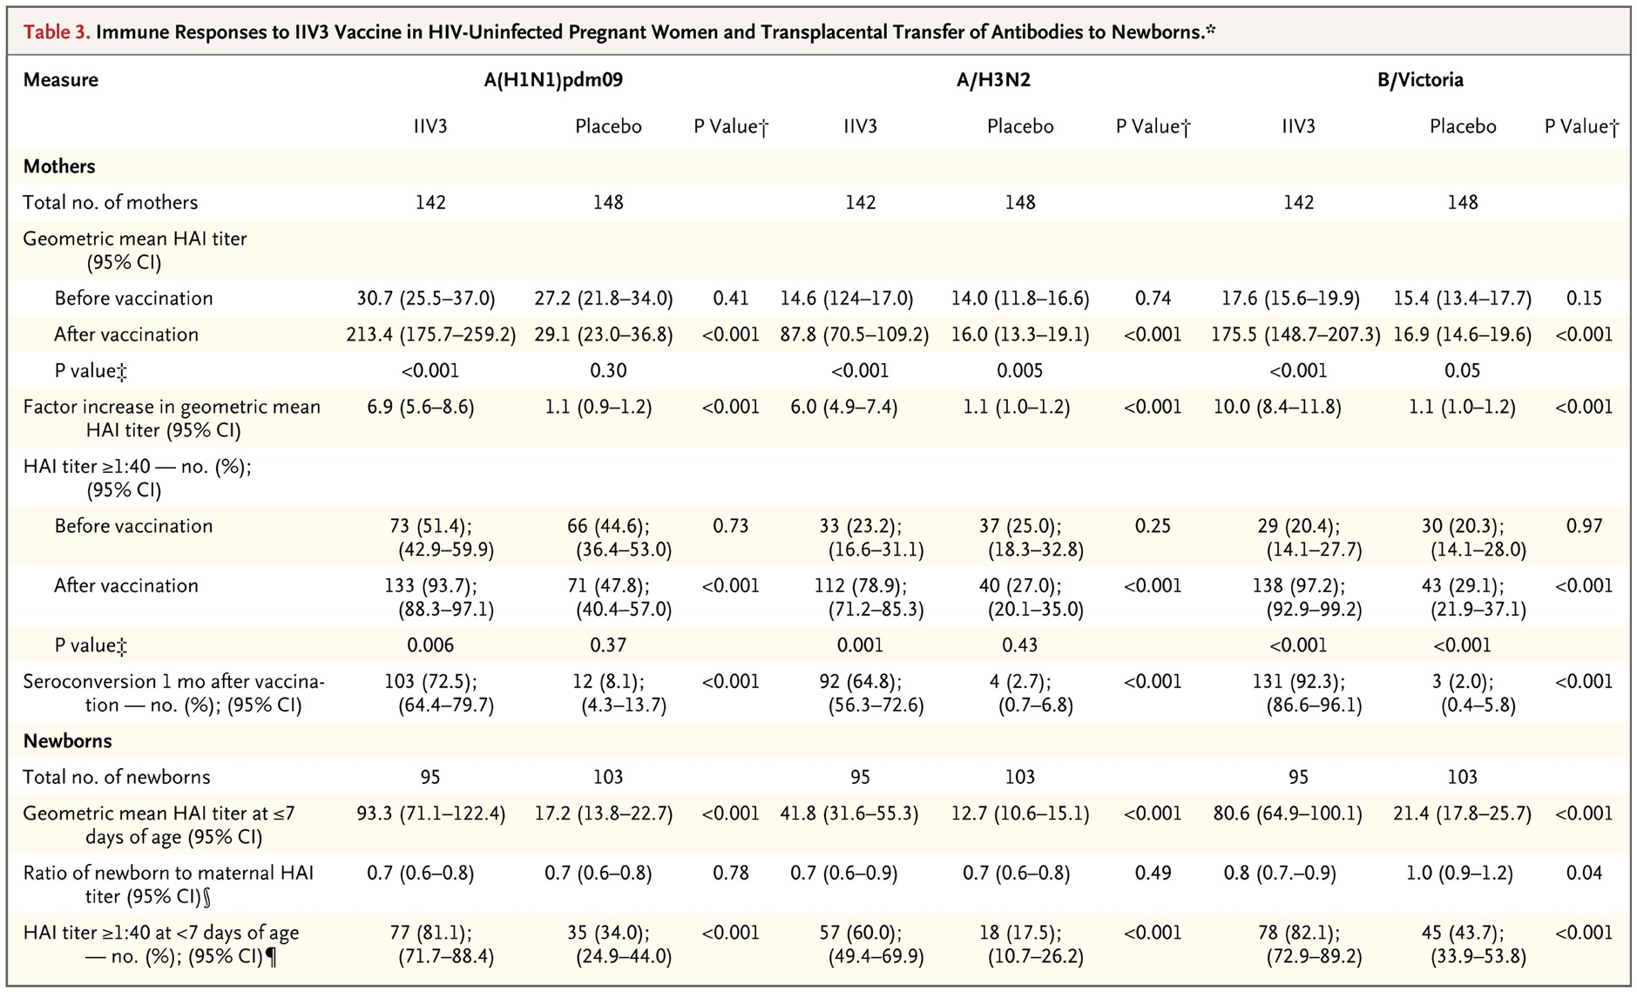

Slide 28
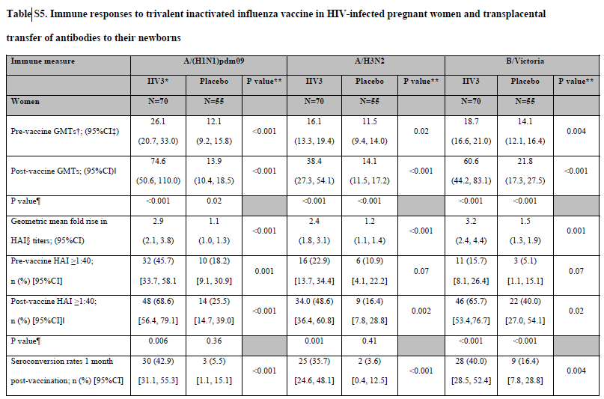

Slide 30
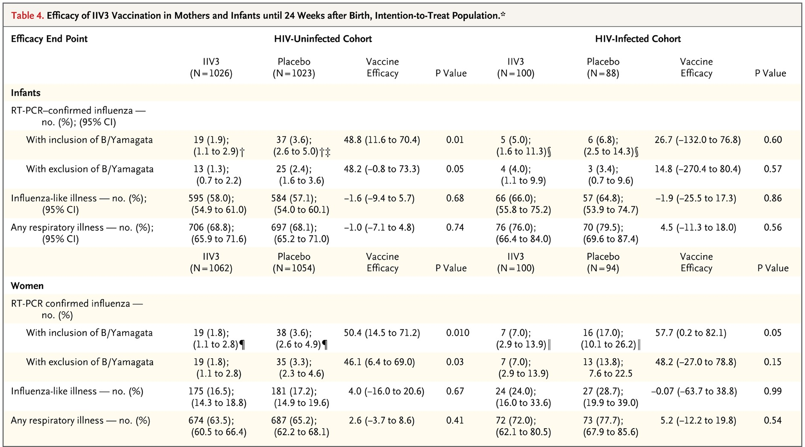

Slide 31
Disscussion
Limitations of study
Conducted at a single center
Timing of enrollment was contingent on the commercial availability of IIV3
Some births occurringafter the influenza season
The difference in duration of exposure to the influenza virus
Lacked power to evaluate vaccine efficacy among the infants of HIV-infected women

Slide 32
Conclusion
IIV3 vaccination in pregnant HIV-uninfected and HIV infected African women was immunogenic and provided protection against confirmed influenza
The vaccination was also effective in HIV-unexposed infants up until 24 weeks after birth

Slide 33
Thank You

Slide 34
Cochrane Database of Systemic Reviews
Vaccines for preventing influenza
First published : 13 March 2014

Slide 35
Healthy adults
No evidence for the utilisation of vaccination against influenza as a routine public

Slide 36
Pregnant women
No randomise controlled trials (RCTs) assessing vaccination in pregnant women
Effectiveness against influenza-like illness (ILI)
Number needed to vaccine (NNV) = 92
Efficacy against laboratory-confirmed influenza in newborn
Number needed to vaccine (NNV) = 27

Slide 37
Conclusion
Very modest effect in reducing
Influenza symptoms
Working days lost
No evidence of association in serious adverse events

