Slide 1
Journal club 1
Facilitator: Pawin Puapornpong

Slide 2
Risk of cancer among women with polycystic ovary syndrome: A Danish cohort study
Gynecologic Oncology 136 (2015) 99–103
Mathilde Gottschau, Susanne Krüger Kjaer, Allan Jensen, Christian Munk, Lene Mellemkjaer

Slide 3
Introduction
Polycystic ovary syndrome (PCOS) is one of the commonest endocrine illnesses in woman
The health consequences of PCOS that are associated with cancer are some of ;
Nulliparity
Obesity
Prolonged unopposed estrogen
Notes:
- Reproductive age
- It is characterized by chronic oligo- or anovulation, hyperandrogenism and polycystic ovaries
- Associated with several long-term health consequences, such as infertility, obesity, hypertension, dyslipidemia, insulin resistance and
type II diabetes mellitus

Slide 4
Introduction
A recent meta-analysis found a significant increase in risk for endometrial cancer among women with PCOS, however ;
Based on few studies
Most of which were case–control studies with small sample sizes
The diagnosis of PCOS was self-reported in most studies
Notes:
five of endometrial cancer, three each of breast cancer and ovarian cancer
So the evidence to support this claim is relatively weak
Large cohort studies are warranted of the entire spectrum of cancer in women with PCOS

Slide 5
Material and methods
Registry-based cohort study during 1977–2012
Danish version of the International Classification of Diseases (ICD)
Danish National Patient Register
The women had to be aged 9–49 years at first admission or visit for PCOS
A total of 12,131 women with PCOS
Notes:
The syndrome can be diagnosed as early as the age of 9
and because it is not clear whether PCOS aftermenopause has a specific phenotype

Slide 6
Material and methods
Linked the cohort of women with PCOS to the Central Population Register to obtain information
The cohort was followed for a total of 91,036 personyears
A total of 12,131 women with PCOS
Excluded
47 (0.4%) : invalid identification number
- 14 (0.1%) : died or emigrated before the diagnosis of PCOS
Leaving 12,070 for analysis
Notes:
The syndrome can be diagnosed as early as the age of 9
and because it is not clear whether PCOS aftermenopause has a specific phenotype

Slide 7
Material and methods
Identifying cancer
Linked to the Danish Cancer Registry
Cancer was diagnosed in 105 women before or on the same date as the diagnosis of PCOS (not included in the analyses)
Notes:
- Not included in the analyses, but the women remained in the cohort as they were at risk for other malignancies

Slide 8
Material and methods
Statistical analysis
Standardized incidence ratios (SIRs)
Corresponding 95% confidence intervals (CIs)
The excess absolute risk
Observed rate - Expected rate per 100,000 person-years
Classified endometrial cancer as type I and II by ICD morphology (modified version by Evans et al)

Slide 9
Results

Slide 10
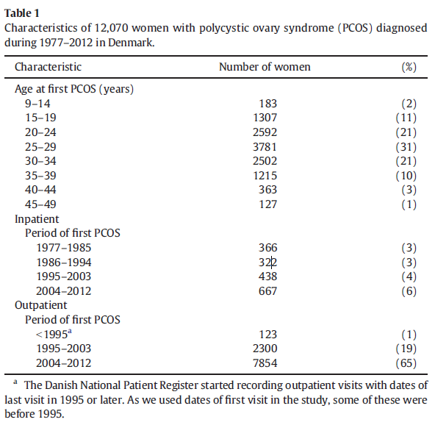
Notes:
- Patients with PCOS increased markedly during the study period

Slide 11
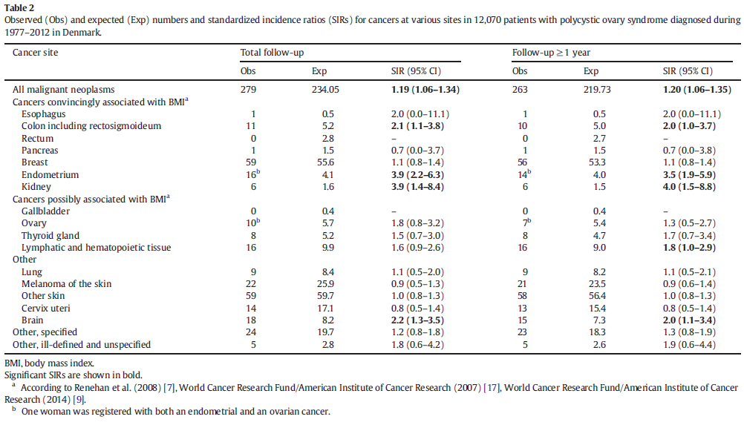

Slide 12
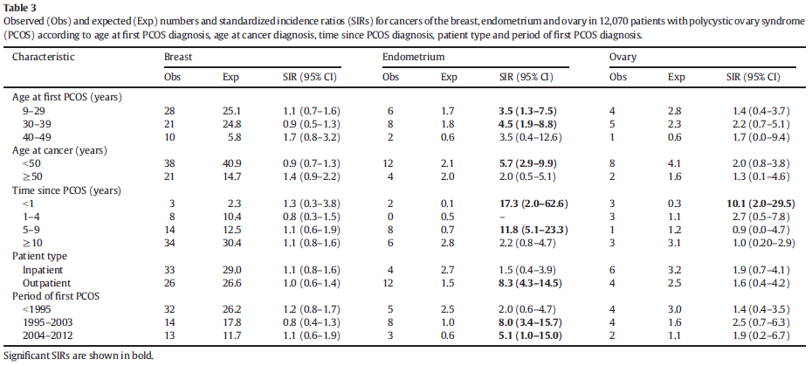

Slide 13
Discussion
In this study, PCOS is associated with an increased risk for endometrial cancer concurs with the results of a recent meta-analysis by Barry et al
Majority of cases were type 1 endometrial cancer
Obesity is a strong risk factor for endometrial cancer but this study could not determine this factor from data
Notes:
Type 1 cancers are associated with long-term exposure to unopposed estrogen
Type 2 lesions are associated with endometrial atrophy and are not estrogen-driven
It is therefore difficult to detect differences in risk for the two tumor types in both our study
and in that of Fearnley et al. [21], in which the subanalyses were restricted to type 1

Slide 14
Discussion
Only 16 cases of endometrial cancer of more than 12,000 women with PCOS
The excess absolute risk of 13.1 per 100,000 person-years
SIR estimates are somewhat underestimated
Notes:
Although we found a fourfold increase in the risk for endometria cancer in our study
- Few extra cases of endometrial cancers among women with PCOS.

Slide 15
Discussion
Limitation is unable to adjust factors that may influence cancer risk
BMI
Metabolic profile
Use of oral contraceptives use and metformin
Number of pregnancies
Age at birth of first child
This change in diagnostic criteria is likely to have increased the number of patients with PCOS
Notes:
The diagnostic criteria for PCOS have changed since
Stein and Leventhal first described the syndrome in 1935
The Rotterdam criteria added polycystic ovaries to the diagnostic criteria of PCOS in 2003

Slide 16
Conclusion
Women with PCOS are at increased risk for endometrial cancer
Restricted to younger women
The overall incidences of breast and ovarian cancer appeared to resemble those of other women
The excess risks for colon, kidney and brain cancer are new findings

Slide 17
Thank You

