Slide 1
Vaginal packing
Facilitator: Pawin Puapornpong

Slide 2
Vaginal packing
INDICATION
emergency treatment for excessive bleeding per vagina, which can occur following cone biopsy, laser to cervix or trauma to the lower genital tract

Slide 3
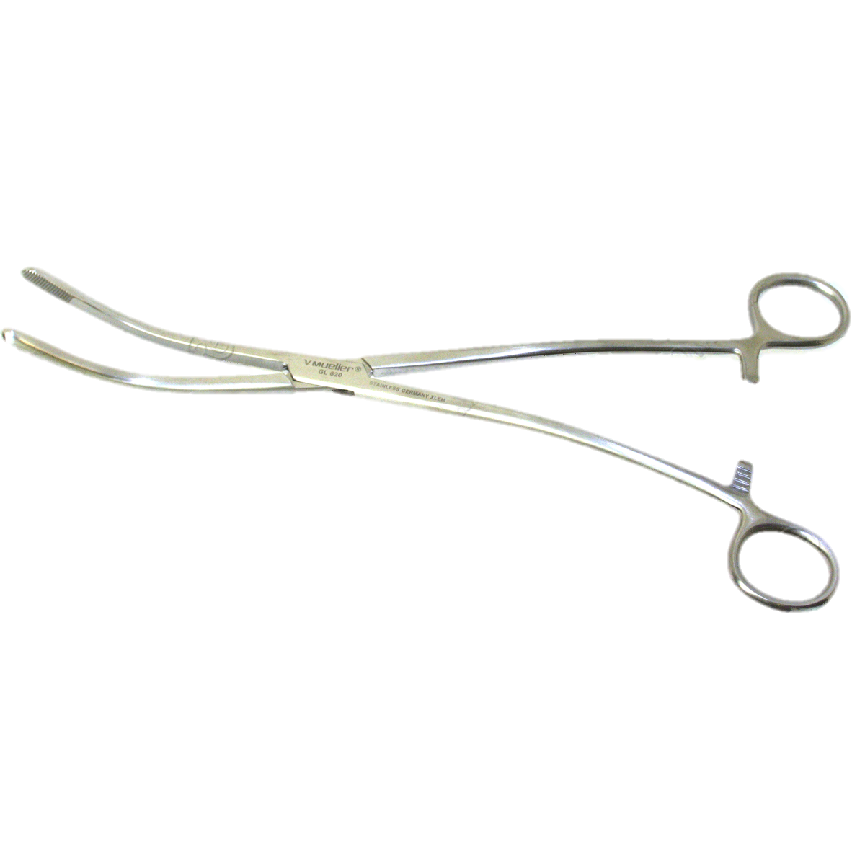
EQUIPMENTS
Sterile bivalve speculum
Sterile sponge holding forceps
Sterile uterine packing forceps
Sterile scissors
Sterile gloves

Slide 4
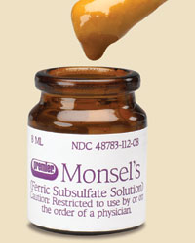
EQUIPMENTS
-Vaseline gauze rolled gauze
-Long sterile buds
-Gauze and cotton swab
-Antiseptic : Savlon
-Normal saline
-Monsel’s paste/silver nitrate sticks
-Foley’s catheter and urine bag
Notes:
Monsel's paste is a thick, sticky, fast-acting compound that is used to cover bleeding

Slide 5
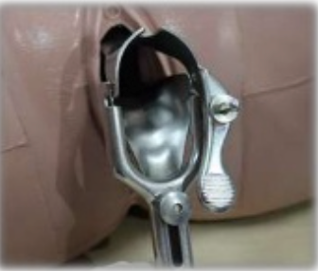
Procedure
Ensure privacy, Explain the procedure to the woman and reassure her.
Offer and administer appropriate analgesia
Lithotomy position
Retain Foley’s catheter
insert bivalve speculum
Use sponge holding forceps and gauze or cotton with antiseptic to clean vaginal wall and remove blood

Slide 6
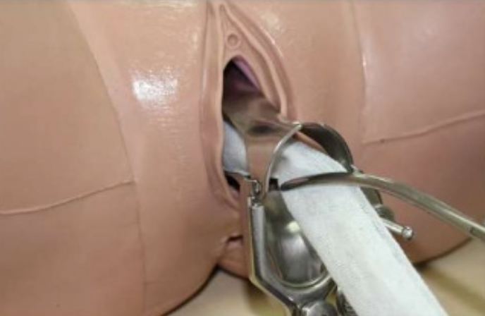
Procedure
Use uterine packing forceps to place vasaline rolled gauze first at fornix area and then cover cervical os
Continue packing try not to leave the space until the gauze reaches hymen

Slide 7
Procedure
Use scissors to cut gauze 1 inch from introitus
Place the perineal pad to observe bleeding
Remove gauze packing within 48 hrs.

Slide 8
THANK YOU

